Slide 1

论文汇报
汇报人：陈冰婷
导师：邹卫琴
延时符

Slide 2
论文导读
Introduction
Ask the Mutants: Mutating Faulty Programs for Fault Localization
MUSE
LIL
MUtation-baSEd fault localization technique, a new fault localization technique basedon mutation analysis.
Locality Information Los, a new evaluation metric for fault localization techniques based on information theory.
延时符

Slide 3
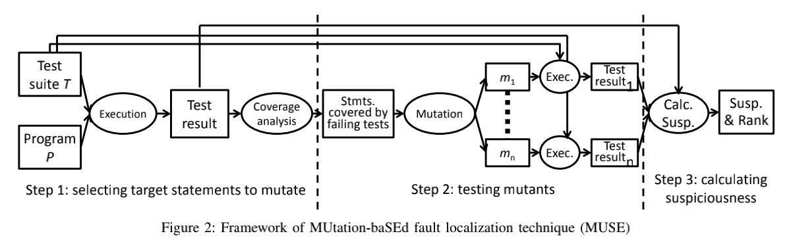
MUSE
Introduction
延时符

Slide 4
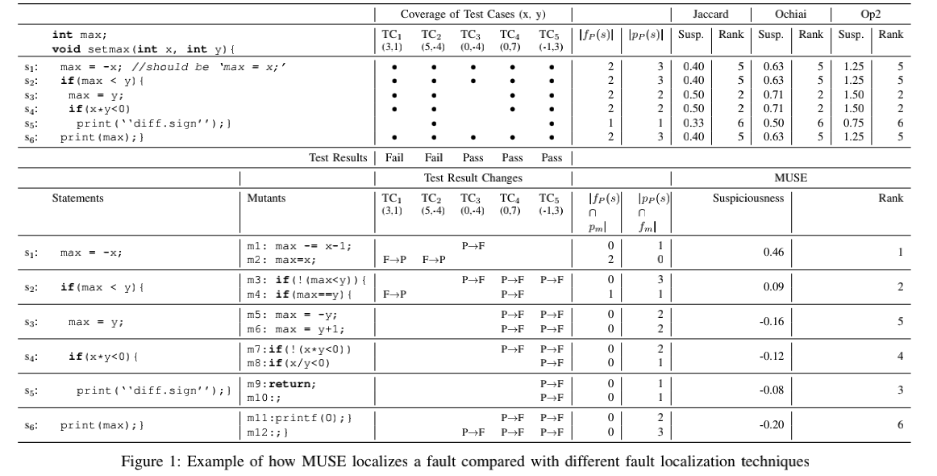
MUSE
Example
延时符

Slide 5




论文导读
Introduction
Two Conjectures
Conjecture 1: test cases that used to fail on P are more likely to pass on $m_{f}$ than on $m_{c}$.
Conjecture 2: test cases that used to pass on P are more likely to fail on $m_{c}$ than on $m_{f}$.
延时符

Slide 6




LIL
Introduction
Why? Expense Metric
Strengths
$$τ∈\left[0，1\right]$$
1
Expressiveness
2
Flexibility
3
Applicability
延时符

Slide 7
未来展望
Future Work
Different Mutation Operators
In-depth study of different mutation operators.
Larger Subject
Apply MUSE to larger subjects such as PHP with multiple test suites.
Other Testing
Apply the mutation idea to conconlic unittesting and concurrent coverage-based testing
延时符

Slide 8
THANK YOU FOR YOUR LISTENING.
谢谢您的聆听

